Slide 1
Rapid Drawdown Analysis
CE 544 – BRIGHAM YOUNG UNIVERSITY

Slide 2
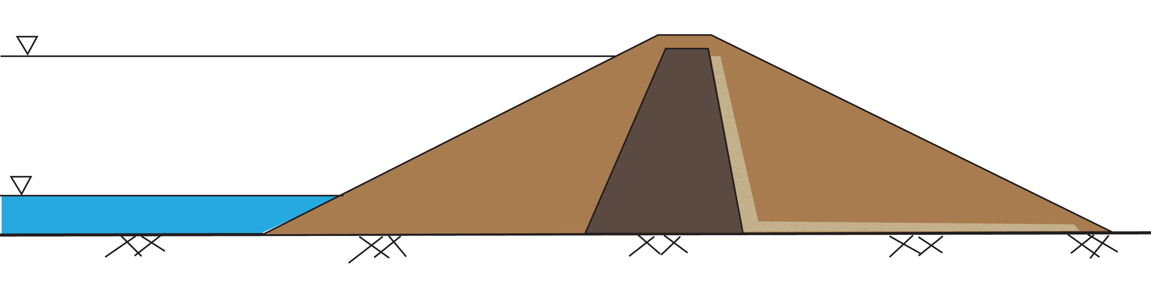
What is rapid drawdown?
Normal Pool
Lowered Pool
Pool lowered rapidly enough that pore water pressures in some soils cannot drain and equilibrate.

Slide 3

When does rapid drawdown apply?
Duncan et al, 1992 suggested using the dimensionless time factor, T:
Where c_{v} = coefficient of consolidation
t = time for drawdown
D = drainage distance
$$T=\frac{c_{v}t}{D^{2}}$$

Slide 4
When does rapid drawdown apply?
T > 3.0 | Drainage should be sufficient – not rapid drawdown
T < 3.0 | Assume rapid drawdown

Slide 5
Approximate values of Cv
Soil Type | c_{v} (ft²/day)
Coarse Sand | > 10,000
Fine Sand | 100 to 10,000
Silty Sand | 10 to 1,000
Silt | 0.5 to 100
Compacted Clay | 0.05 to 5
Soft Clay | < 0.02
Taken from Duncan et al, 1992

Slide 6
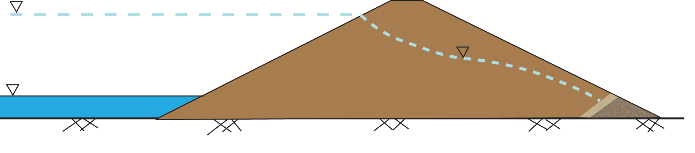
Example 1
Normal Pool
₂
₂
₁
₁
_{50’}
_{D = 35’}
Lowered Pool
_{Compacted Clay}
_{cv = 2 ft²/day}
T = cvt/D², if t = 50 days, T = 0.08 < 3.0 Rapid Drawdown

Slide 7
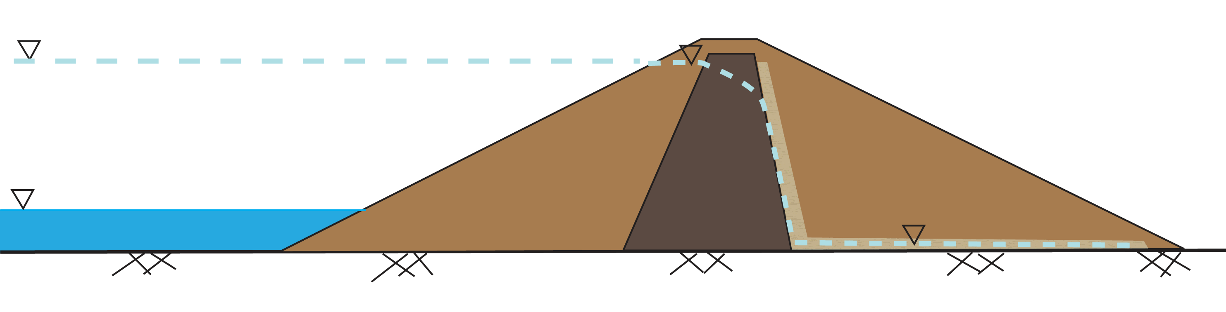
Example 2
_{Compacted Clay}
_{cv = 2 ft²/day}
_{Fine Sand}
_{cv = 200 ft²/day}
Normal Pool
₂
₂
₁
₁
_{50’}
_{31’}
Lowered Pool
_{14’}
Shell: Ts = cvt/D², if t = 50 days, Ts = 10.4 > 3.0 Not Rapid Drawdown
Core: Tc = cvt/D², if t = 50 days, Tc = 0.5 < 3.0 Rapid Drawdown

Slide 8
Drawdown at end of construction
Soil has not had time to fully consolidate to long-term conditions
Freely draining soils
Use effective stresses and pore pressures from post-drawdown conditions
Poorly draining soils
Use strengths from unconsolidated undrained tests

Slide 9
Drawdown for long-term conditions
This condition requires a more sophisticated approach
Freely draining soils
Use effective stresses and pore pressures
Poorly draining soils
Undrained strengths depend on consolidation stresses prior to drawdown
Use a multi-stage analysis

Slide 10
Three-Stage Method
Rapid Drawdown Analysis

Slide 11
Three-Stage Method
Preferred Method
Developed by Duncan, Wright, & Wong
Stages
Compute effective stresses based on pre-drawdown conditions
Compute FS for post-drawdown conditions using total stress analysis. Undrained strength is a function of effective stress from stage 1.
Compute FS for post-drawdown conditions using drained strengths
The lower FS from stages 2&3 is used

Slide 12
Stage 1
Performed for conditions prior to drawdown
Objective is to estimate effective stresses along the slip surface prior to drawdown

Slide 13
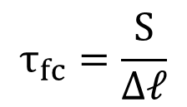
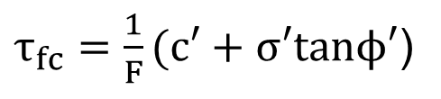
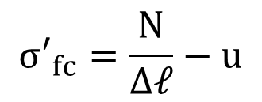
Stage 1, cont.
First stage stability computations are used to compute the shear stress and effective normal stresses on the slip surface.
$$σ′_{fc}=\frac{N}{Δ𝓁}−u$$
$τ_{fc}=\frac{1}{F}(c′+σ′tanϕ′$)
$$τ_{fc}=\frac{S}{Δ𝓁}$$

Slide 14
Stage 1 , cont.
Steady state seepage is assumed
The effective stresses (σ_{fc}) represent the stresses on the failure plane at the end of consolidation (hence the subscript “fc”)
These stresses are used to estimate the undrained shear strength in stage 2

Slide 15
Stage 2
Undrained shear strengths and total stress analysis is used for low-k zones
Undrained strengths are estimated using the consolidation stresses computed in stage 1
Driving forces are calculated using post-drawdown conditions

Slide 16
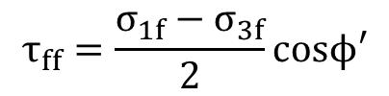

Stage 2, Effective Stresses
$$τ_{ff}=\frac{σ_{1f}−σ_{3f}}{2}cosϕ′$$
τ_{ff} = shear stress on the failure plane at failure
$$\frac{σ′_{1f}−σ′_{3f}}{2}$$
The τ_{ff} values are then paired with the corresponding σ_{fc} values to generate a new type of plot (see next slide) for use in calculations

Slide 17
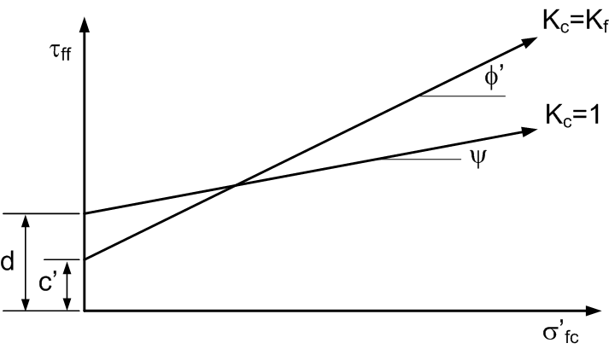
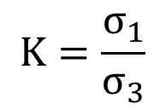
Stage 2, Anisotropy
$$K=\frac{σ_{1}}{σ_{3}}$$
K_{c} = K during consolidation stage
K_{f} = K at failure
Note that the K_{c}=K_{f} line for CU triaxial test is the same envelope as the one obtained from the CD or CU (drained) triaxial test. The K_{c}=1 line represents τ_{ff} vs. σ’_{3c} from CU triaxial tests. τ_{ff} is found using equation on previous slide. Thus, both lines can be obtained from one set of CU triaxial tests.

Slide 18

Stage 2 - K interpolation
$$K_{c}=\frac{σ′_{1c}}{σ′_{3c}}$$

Slide 19
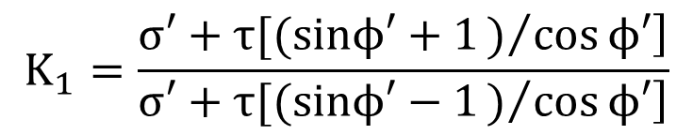
Stage 2 - K interpolation
K₁ = the effective principal stress ratio for consolidation corresponding to the stage 1 analyses.
$$K_{1}=\frac{\left.σ′+τ[(sinϕ′+1)/{cos}ϕ′\right]}{\left.σ′+τ[(sinϕ′−1)/{cos}ϕ′\right]}$$
Where σ’ and τ are the effective normal and shear stresses on the shear plane at the end of consolidation.
This equation assumes that the orientation of the principal stresses at the end of consolidation is the same as orientation of the principal stresses at failure.

Slide 20
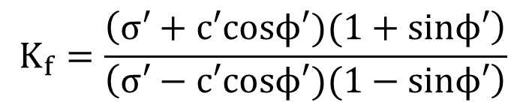
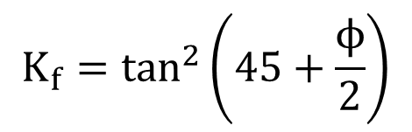
Stage 2 - K_{f}
K_{f} = the effective principal stress ratio at failure for the stage 1 analyses. It can be found from:
$$K_{f}=\tan^{2}\left(45+\frac{ϕ}{2}\right)$$
(no cohesion)
$$K_{f}=\frac{\left(σ′+c′cosϕ′)(1+sinϕ′\right)}{\left(σ′−c′cosϕ′)(1−sinϕ′\right)}$$
(with cohesion)

Slide 21
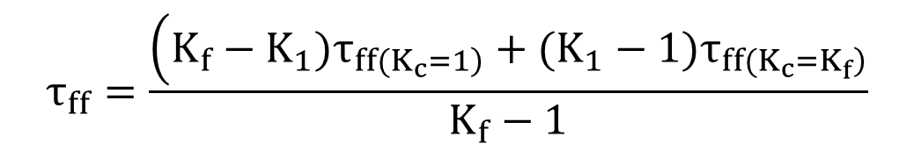
Stage 2 - K interpolation
Values of the undrained shear strength for the effective consolidation pressure σ’ and a consolidation ratio K_{c}=K₁ are obtained by interpolating the K_{c}=1 and K_{c}=K_{f} failure envelopes using the following equation:
$$τ_{ff}=\frac{\left(K_{f}−K_{1})τ_{\left.ff(K_{c}=1\right)}+(K_{1}−1)τ_{\left.ff(K_{c}=K_{f}\right)}\right.}{K_{f}−1}$$
The two τ_{ff} values are found by evaluating the two envelopes using the σ’_{fc} found from stage 1.

Slide 22
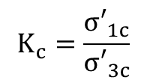
Stage 2 – Negative Stresses
If significant cohesion exists, the σ’₃ values can become negative, leading to a negative (and meaningless) K value.
In this case, we use the lower of the K_{c}=1 and K_{c}=K_{f} curves.
$$K_{c}=\frac{σ′_{1c}}{σ′_{3c}}$$

Slide 23
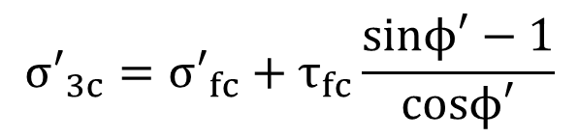
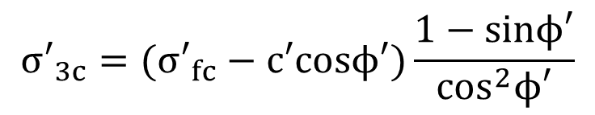
Stage 2 – Negative Stresses
Negative effective stresses can be checked using the following two equations:
$$σ′_{3c}=σ′_{fc}+τ_{fc}\frac{sinϕ′−1}{cosϕ′}$$
(K_{c}=1 envelope)
$$σ′_{3c}=(σ′_{fc}−c′cosϕ′)\frac{1−sinϕ′}{\cos^{2}ϕ′}$$
(K_{c}=K_{f} envelope)
If either is negative, no interpolation is required and we use the lower of the two strength values coming from the two curves.
Notes:
This is consistent with the textbook on page 156, but it doesn’t make sense. He claims that the first equation is from the Kc=1 envelope but he says it is derived from equation 9.10 which is for the K1 condition, not Kc=1. Furthermore, how do you even have taufc if K=1? Doesn’t make sense at all. Furthermore, if it is for Kc=1, why are not using psi rather than phi in the equation?
Furthermore, why not just check to see if K1 or Kf is negative? Wouldn’t that be sufficient?

Slide 24
Stage 2, FS Calculations
After the undrained strengths are computed for low K zones, FS is calculated
Drained strengths are used for high K zones
Driving forces (based on weight of slices) are calculating using post-drawdown conditions

Slide 25
Stage 3
Undrained strengths used for slices in low K zones are compared with drained strengths
If drained strength is lower than the undrained strength, the drained strength is assigned to that slice and the FS is re-calculated
Note that some slices may used drained strength while others may use undrained.
If drained > undrained for all slices, there is no need to re-calculate FS

Slide 26

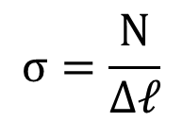
Stage 3, cont.
For drained strength calculations:
$$σ=\frac{N}{Δ𝓁}$$
$$s=c′+(σ−u)tanϕ′$$
The pore pressure u is found from post-drawdown conditions.

Slide 27
Stage 3, cont.
If stage 3 calculations are required (drained less than undrained in at least one slice), then the FS from stage 3 = the rapid drawdown FS
If stage 3 calculations are not required, the FS from stage 2 = the rapid drawdown FS

